Slide 1


Regenstrief Institute’s Next-Generation Clinical Decision Support System
Jon D. Duke, MD, MS
Burke Mamlin, MD
Doug Martin MD
Notes:
The Regenstrief Institute, a pioneer in physician order entry and clinical decision support systems, is currently in the midst of deploying a new platform built on open-source technologies. The centerpiece of this effort is G3, a CPOE designed to support advanced research in clinical decision support, usability, physician workflow, and patient safety. We will be demonstrating this new system, with a focus on its interface design, CDS architecture, natural language processing capabilities, and provider communications. We will also be discussing our user-centered design process, opportunities for collaboration, and future development plans.

Slide 2


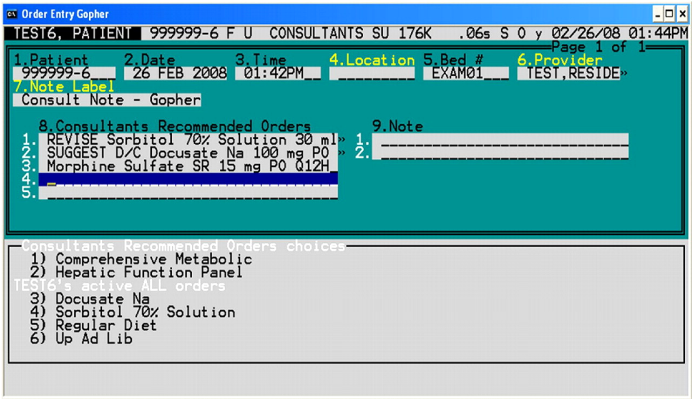

Slide 3
Gopher
Gopher grew from a single clinic to over 1000 workstations, inpatient and outpatient
25+ years of iterations has resulted in robust functionality and efficiency
Served as the research platform for many of the seminal studies in healthcare computing

Slide 4
1984
2010

Slide 5
Developing the new Gopher
In 2009 Regenstrief Institute began rebuilding its core clinical information system platform
In 2010, we began work on a new web-based version of the venerable Gopher
This system was designed using the knowledge gained from the past 25 years of Gopher as well as from the evolving literature on CPOE system design

Slide 6
What’s in the new Gopher?
Results display
Recent results
Flowsheet
Clinical abstract
Clinical documents
Encounter display
Order summary
Appointment history
Patient dashboard
Medication summary
Chart search
Data capture
Order entry
Note Writing
Observations
Patient Letters
Document uploader
Electronic signature
Problem list management
Allergy Management
Order Sets
Natural Language Processing
Clinical Decision support
Alert display
InfoPanel
Rule Authoring
Relevance Adjustment Module
FDB Integration
Multi-setting support
Outpatient
Inpatient
Emergency Department
Administrative Tools
User management
Remote troubleshooting
Property management
Concept mapping
Disaster aid support
System integration
McKesson portal
Relay Health portal
Docs4Docs integration
Research
Randomization
Medication adherence
Medication reconciliation
Med profile visualization
ResNet Recruitment
SMART plug-ins
Certifications
Meaningful Use Inpt / Outpt
NCPDP e-Prescribing
Reporting
Population search
Notes:
Switch to demo – show plugins, help content, about box, design mode.

Slide 7
Major Functions
Order entry
Documentation / note writing
Medication / problem / allergy management
Results viewing
Research
Clinical decision support
Notes:
Is there a current visual map of all the plugins and functionalities of G3?

Slide 8
Major Functions
Order entry
Documentation / note writing
Medication / problem / allergy management
Results viewing
Research
Clinical decision support
Notes:
Is there a current visual map of all the plugins and functionalities of G3?

Slide 9

Started with a Blank Slate

Slide 10
Guiding Principles
Support Patient Safety
Improve Quality of Care
Improve User Satisfaction
Promote Provider Efficiency

Slide 11
Usability Goals
Minimal Training Necessary
Novice & Expert Friendly
Keyboard & Mouse Friendly
Stay Out of User’s Way

Slide 12
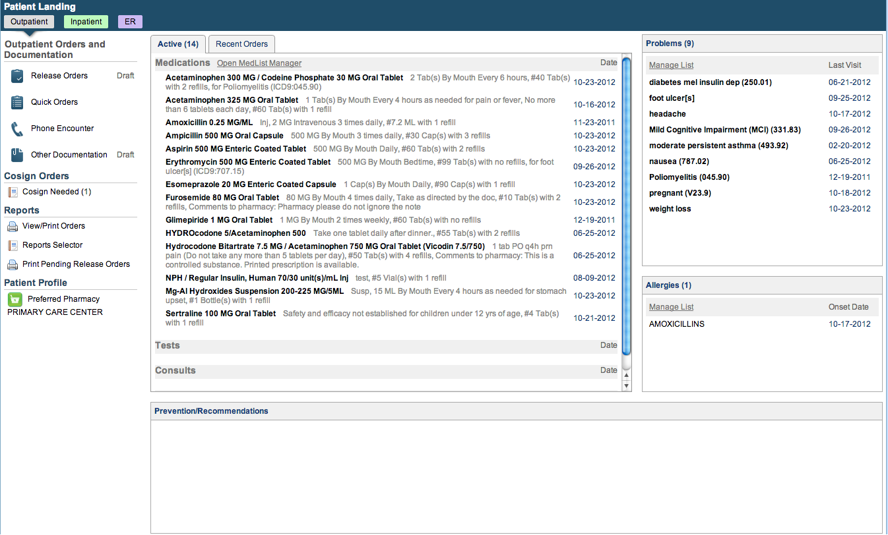

Slide 13
Architecture
User
Interface
Order
Entry
Flowsheet
User Preferences
SMART
Plug-in
Chart Search
Plug-in
Widgets
Electronic
Signature
Patient
Selection
User
Authentication
SMART Adaptor
Plug-in
Services
Layout
Manager
Layout
Designer
Framework
Services
Internal
Services
Electronic
Signature
Patient
Context
User
Context
SMART
API Registry
Plug-in
Services
Context
Management
Event
Management
Component
Registration
Help
Subsystem
Theme
Support
Framework
Services
External
Services
Data
Access
Security
Services
Messaging
Services
Web
Services
Solr Search Engine
Core
Services

Slide 14
CDS Advancements in Gopher
Dynamic Alerting
Real-time Natural Language Processing
Chart Search
InfoPanel
Recipe Authoring

Slide 15
Advancement #1: Alerting
Context-driven dynamic alerts
Alerts that learn
Alert aggregation
Multimedia content

Slide 16
Dynamic Alerts
Embedded mechanics to dynamically change the alert display based on context
Patient
Physician
Institutional

Slide 17
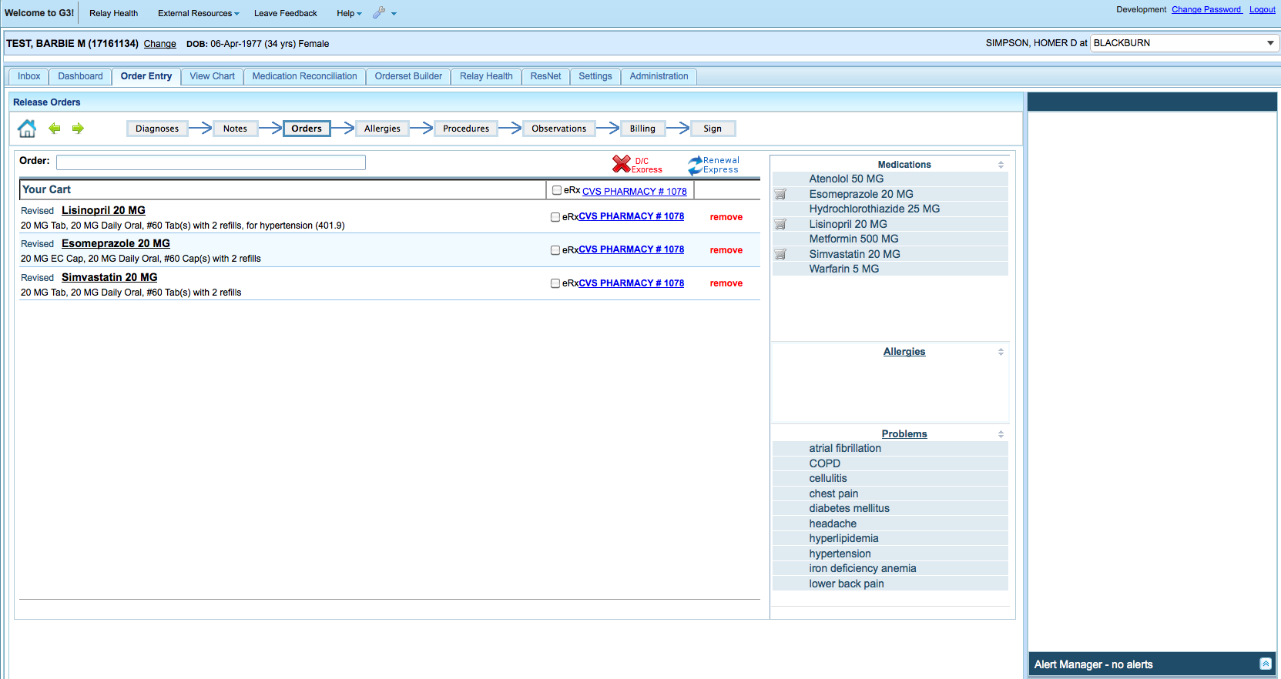
Alerting Zones

Slide 18
Relevance Adjustment Module
Every alert has a baseline relevance level which determines its display location
For example, for DDI alerts, about 40% are interruptive and 60% non-interruptive
The RAM can adjust this default level

Slide 19
Lisinopril Order
Original Alert
Final Alert
TRIAMTERENE Interacts with LISINOPRIL
Risk of Hyperkalemia
Severity: Moderate
Relevance: 5 (Average)
DDI
Alert Service
TRIAMTERENE Interacts with LISINOPRIL
Risk of Hyperkalemia
K 5.3*, Cr 1.3, GFR 55
Relevance: 7 (High)
Relevance Adjustment Module
Data
Repository
Related Concepts
K, Cr, GFR
Hyperkalemia Has Relevant Labs:
K, Cr, GFR
Patient has lab values:
K 5.3*, Cr 1.3, GFR 55

Slide 20
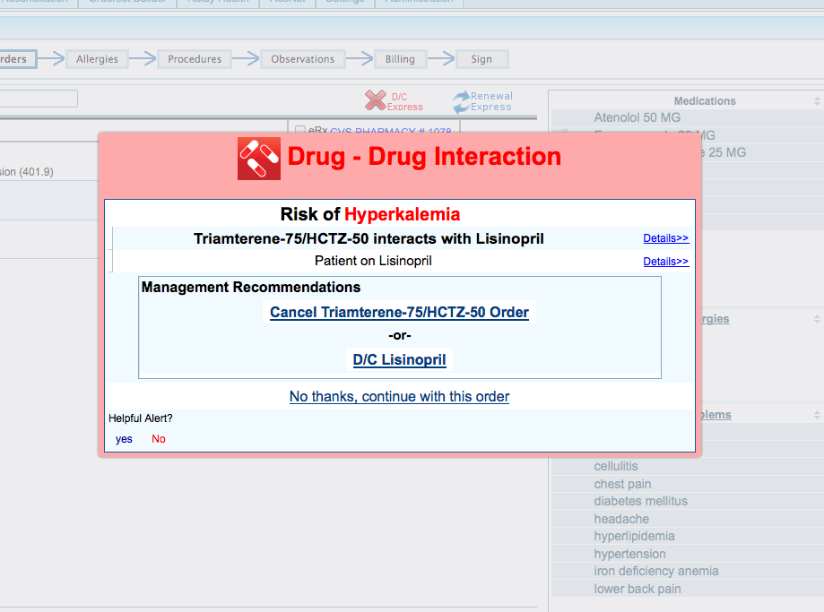

Slide 21
Lisinopril Order
Original Alert
Final Alert
TRIAMTERENE Interacts with LISINOPRIL
Risk of Hyperkalemia
Severity: Moderate
Relevance: 5 (Average)
DDI
Alert Service
TRIAMTERENE Interacts with LISINOPRIL
Risk of Hyperkalemia
K 3.3, Cr 0.8, GFR 114
Relevance: 3 (Low)
Relevance Adjustment Module
Data
Repository
Related Concepts
K, Cr, GFR
Hyperkalemia Has Relevant Labs:
K, Cr, GFR
Patient has lab values:
K 3.3, Cr 0.8, GFR 55

Slide 22
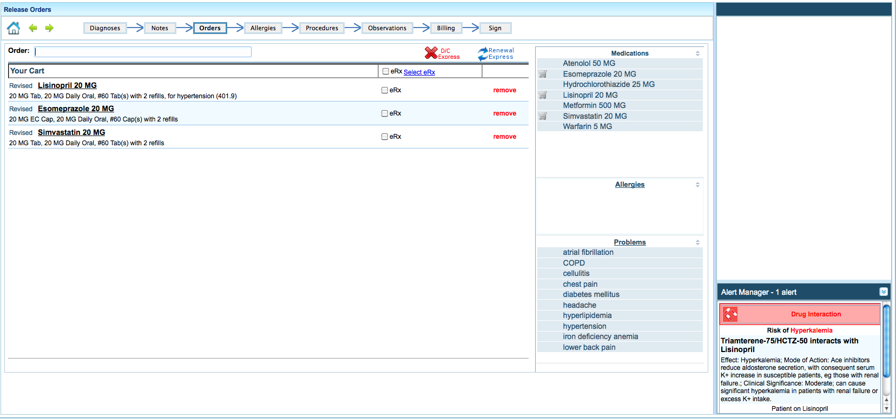

Slide 23
Relevance Adjustment Module
RAM can also make changes based on provider characteristics
For example, can make particular alerts non-interruptive for certain specialties
Conversely, for medical students all alerts can be made interruptive

Slide 24

Learning
Mastery
TM Nintendo

Slide 25
G3 is a Learning System
G3 can track user actions and activity such as
Number of logins
Frequently selected orders
Responses to previous alerts
Can customize system behavior based on individual user history

Slide 26
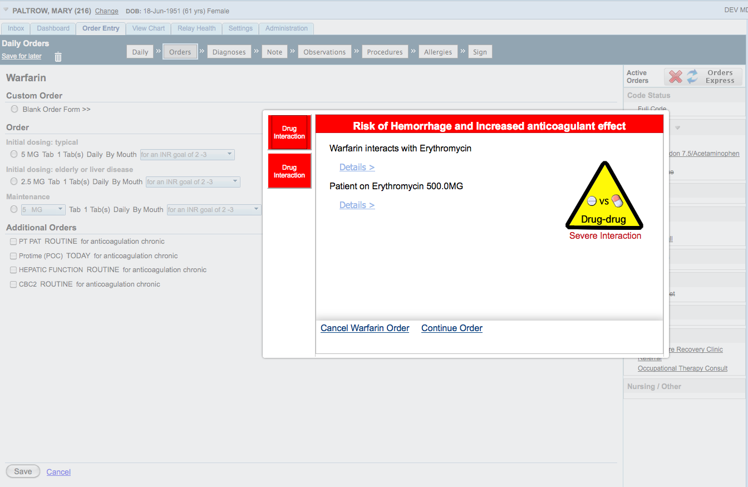
Alerts That Learn
Picture of learning message, then another of the small alert
Diazepam
Diazepam 5 MG

Slide 27
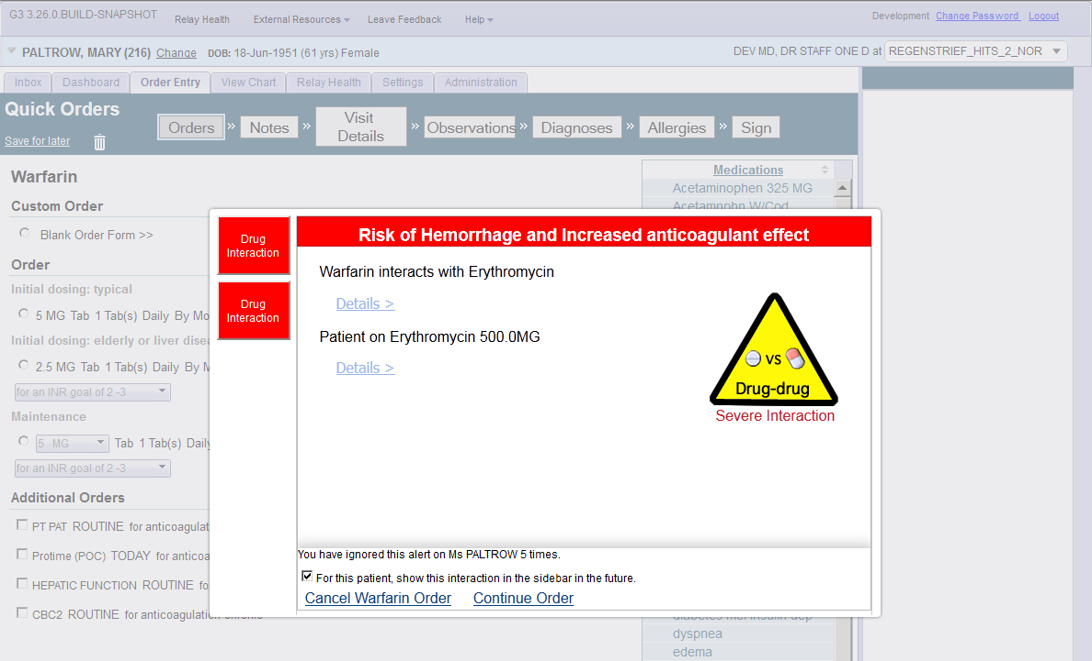
Alerts That Learn
Diazepam
Diazepam 5 MG

Slide 28
Alert Aggregation
Can receive multiple alerts for the same order simultaneously
Sought to centralize the alerting and also provide quick overview of the safety concerns
Notes:
Should we put in dismiss all?

Slide 29
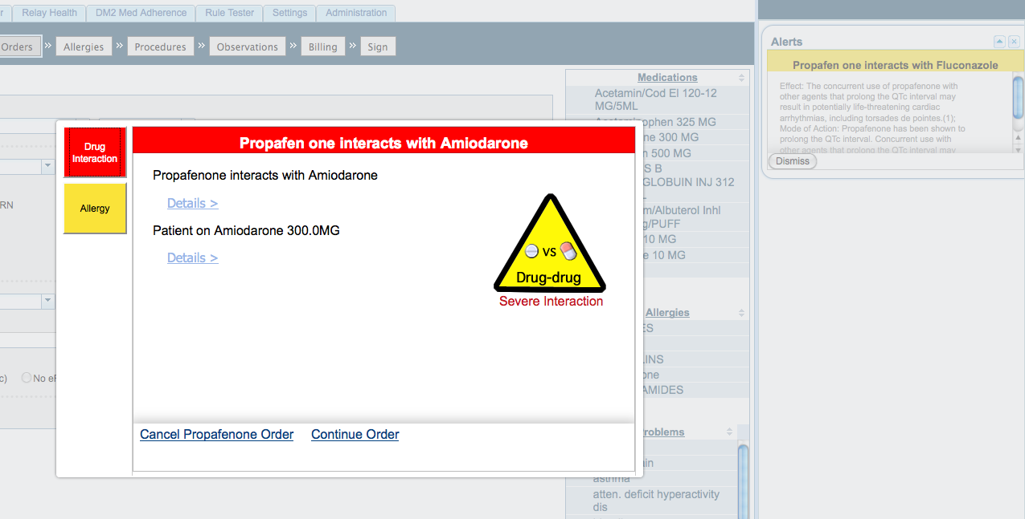

Slide 30
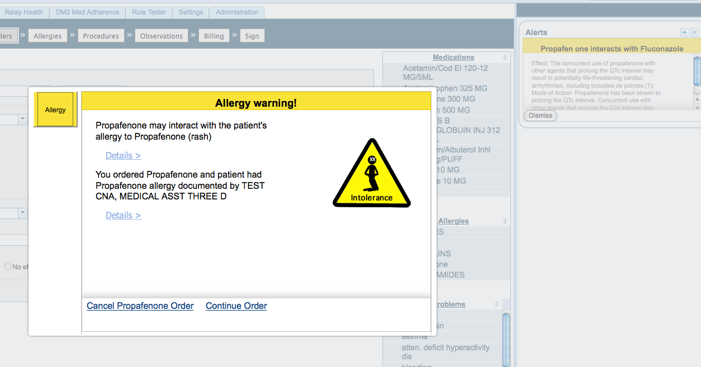

Slide 31
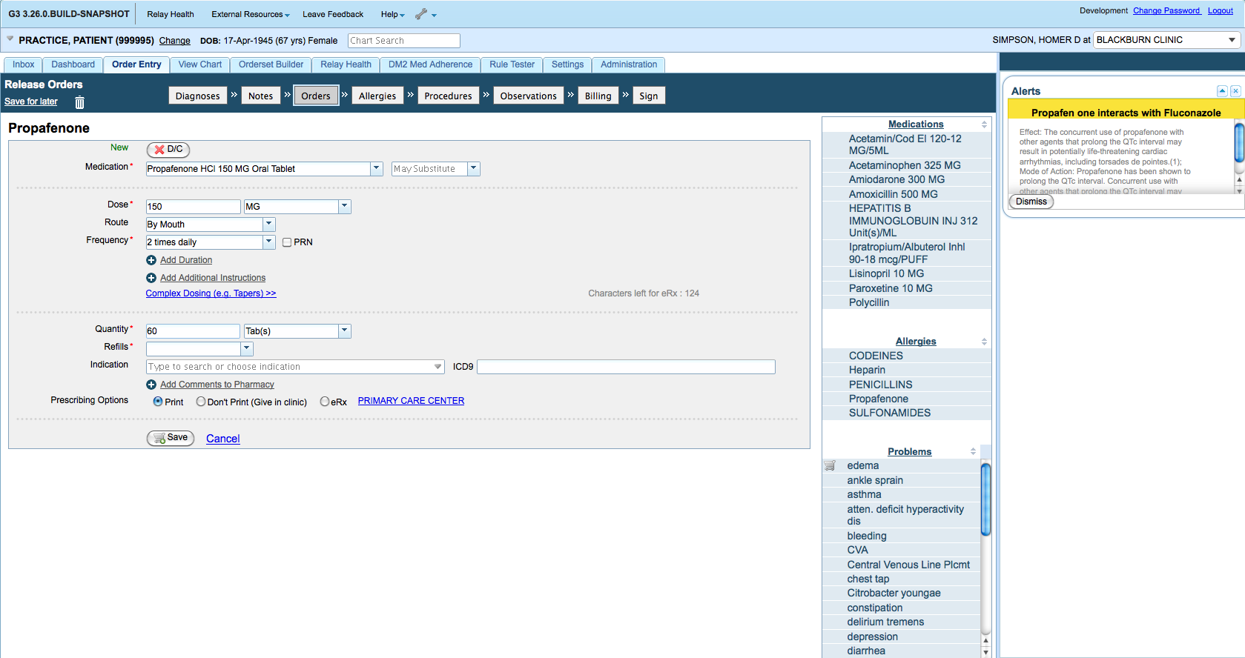

Slide 32
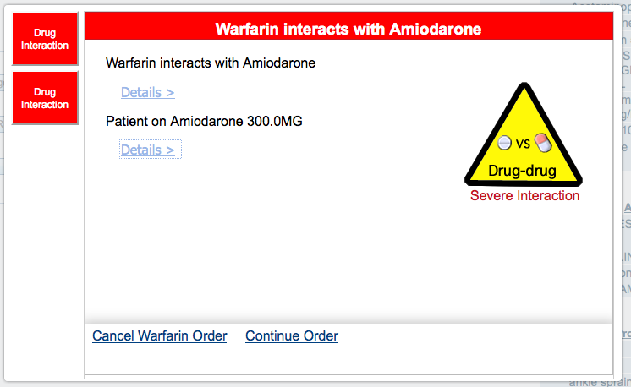
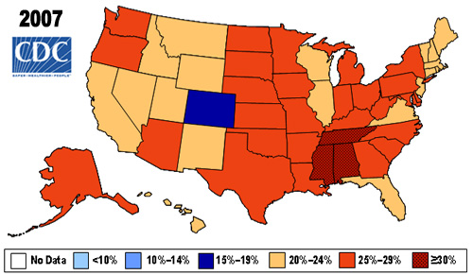

Multimedia Alerts
G3 alerts can embed pictures, video, hyperlinks

Slide 33
Advancement #2: Natural Language Processing
Can analyze notes in real-time
Can determine section (e.g., FHx, PMH) to give context to the concepts retrieved
Multiple services may be run simultaneously (e.g.,CDS, quality metrics, study recruitment)
Results may be displayed as alert or used for background data capture
Section header detection thanks to SecTag from Vanderbilt University:
http://knowledgemap.mc.vanderbilt.edu/research/content/sectag-tagging-clinical-note-section-headers

Slide 34
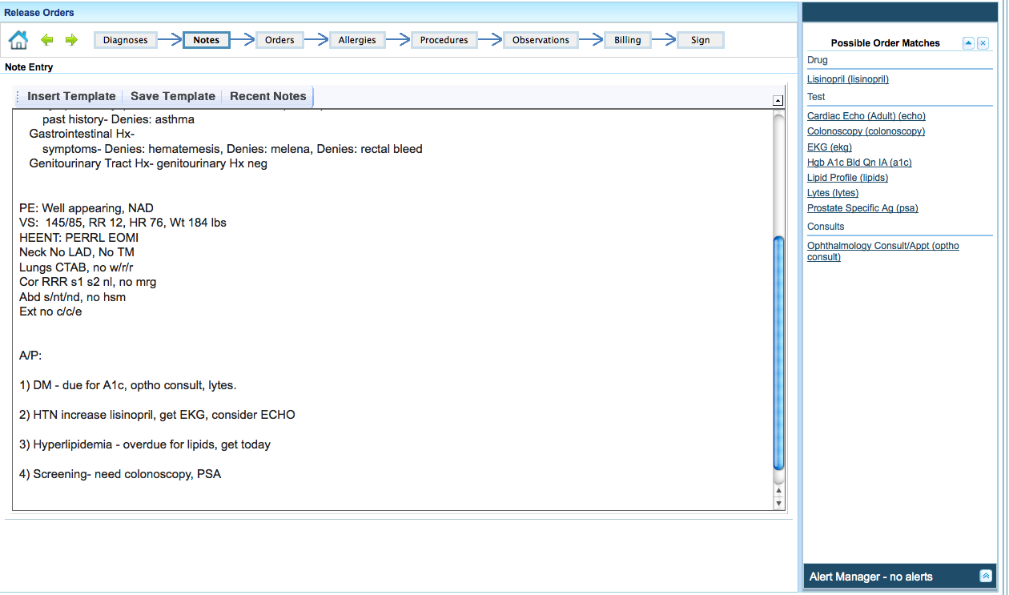
Order Detection

Slide 35
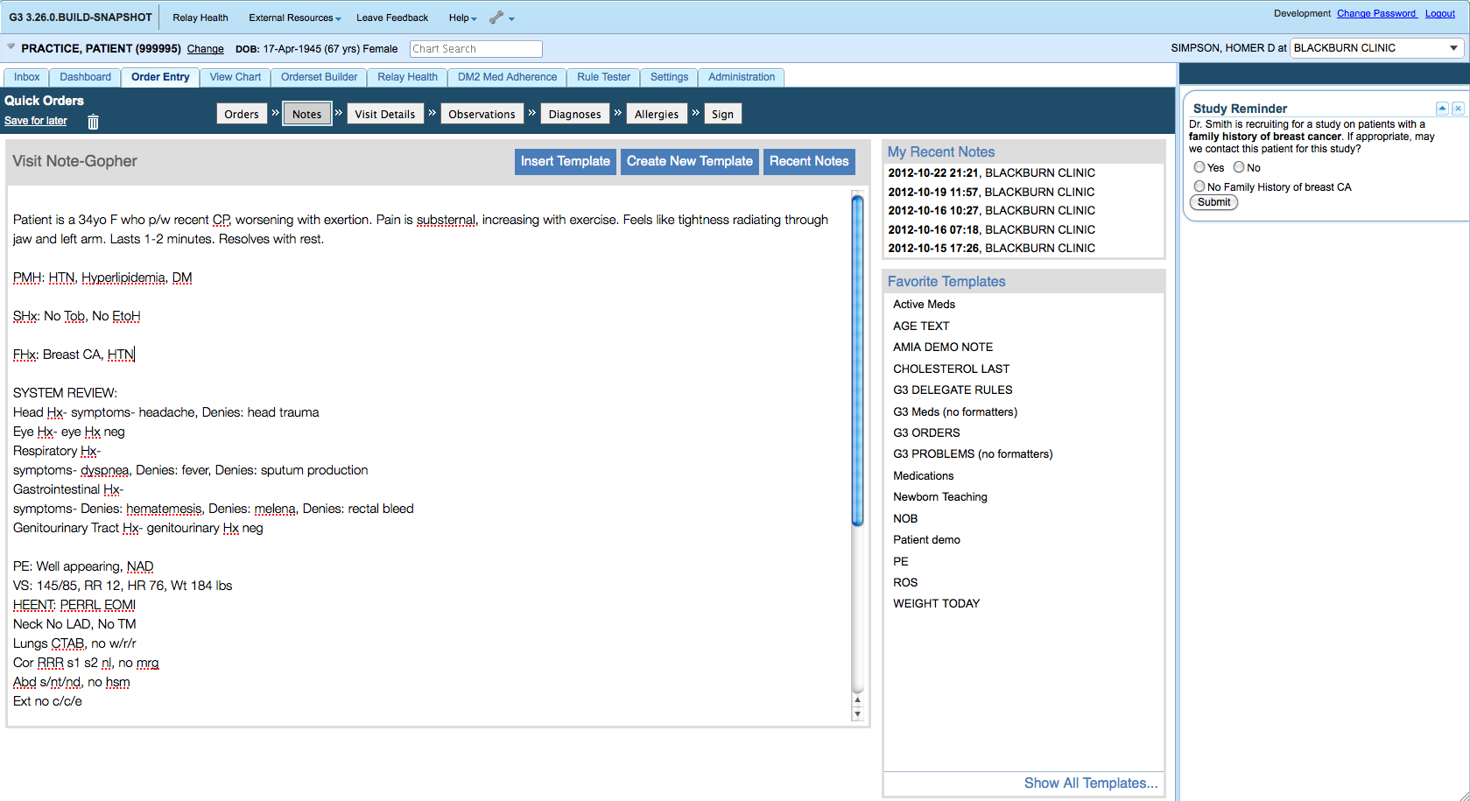
Study Reminders

Slide 36
Natural Language Processing
Can be used as a CDS trigger
Can be used to enhance structured documentation for ‘meaningful use’
Can be used for clinical research
Just beginning to explore the possibilities

Slide 37
Advancement #3: Chart Search
Google-like search within patient chart
Rapid retrieval of specific events, studies, physician notes
See lab trends, medication histories

Slide 38
Chart Search
Patient Selected
User Query
User
Patient Record
Medical Record
Indexing Request Queue
Index Builder
Index
Query Engine
Solr/Lucene
External
Appointment Batch Processor
ADT Trigger

Slide 39
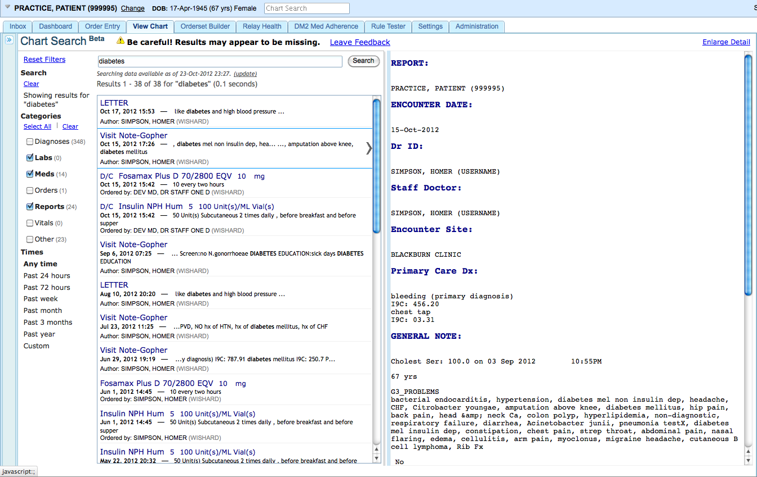

Slide 40
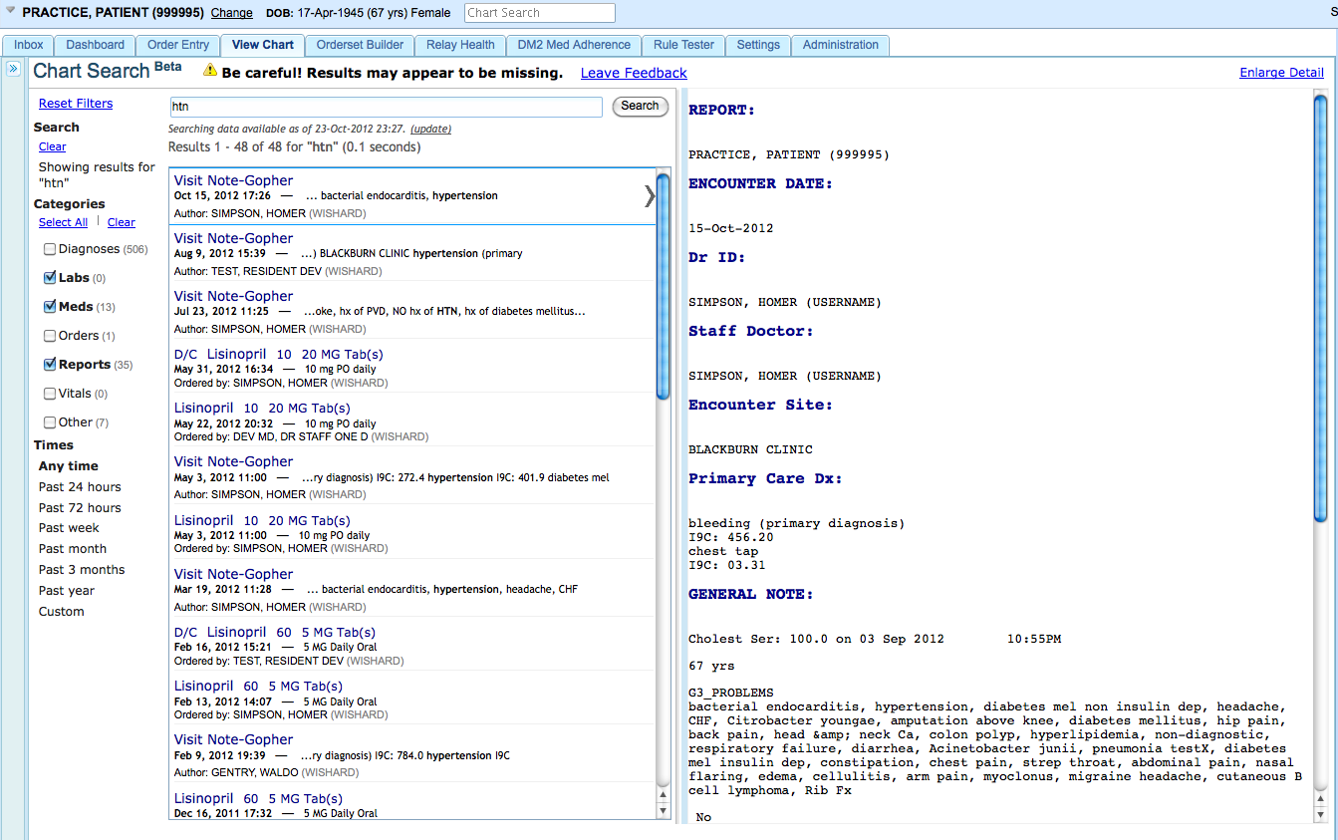

Slide 41
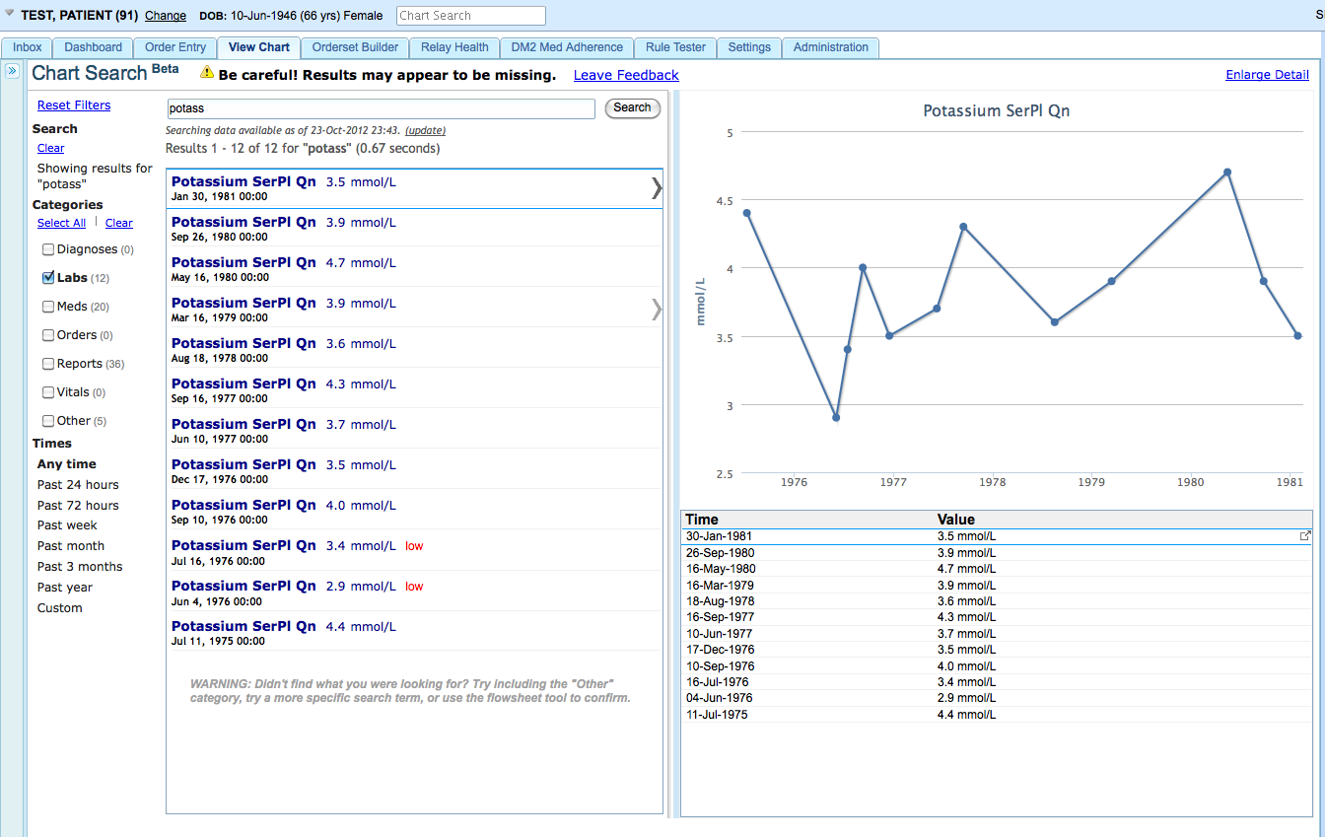

Slide 42
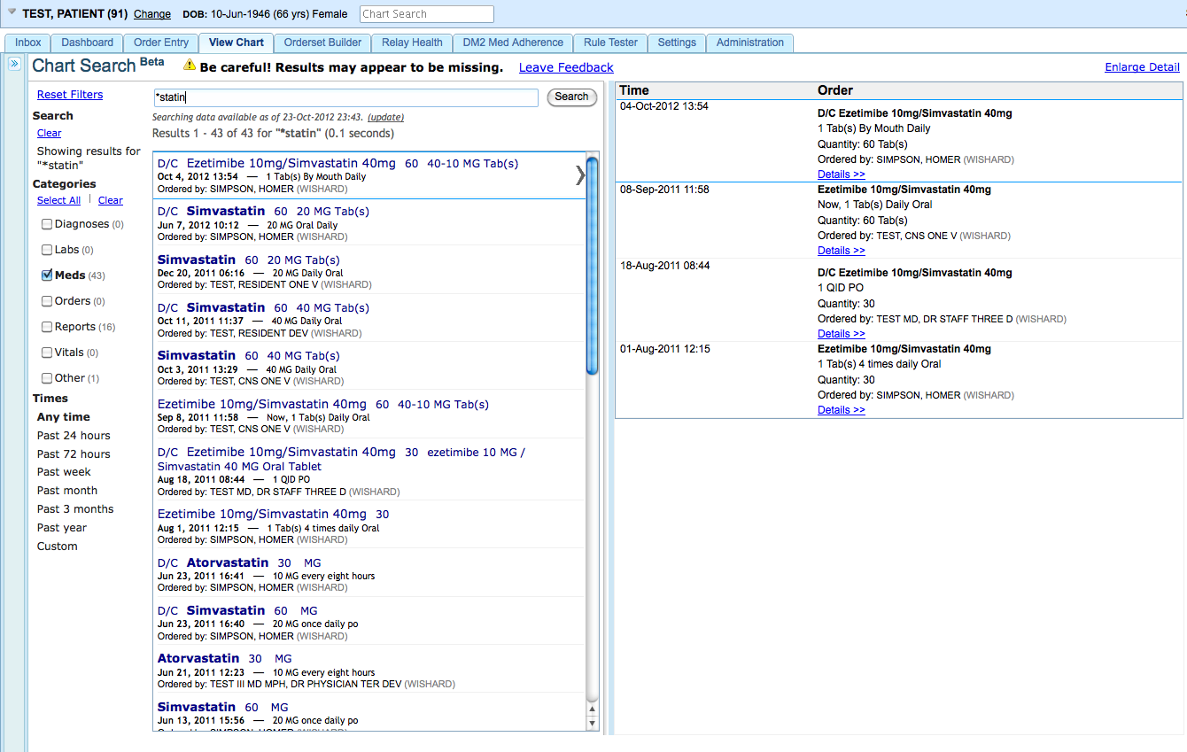

Slide 43
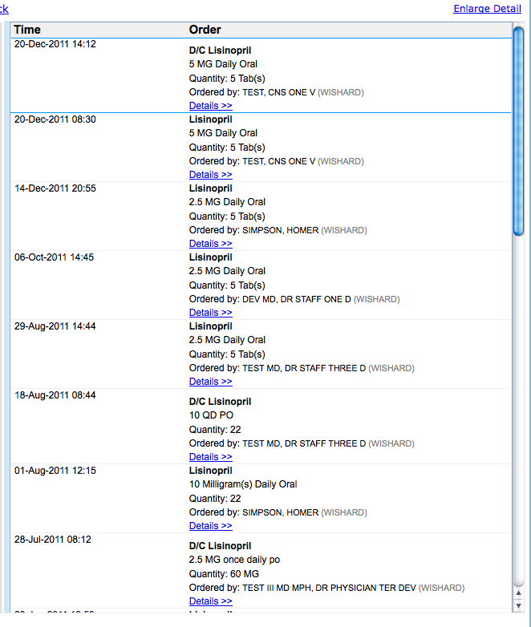

Slide 44
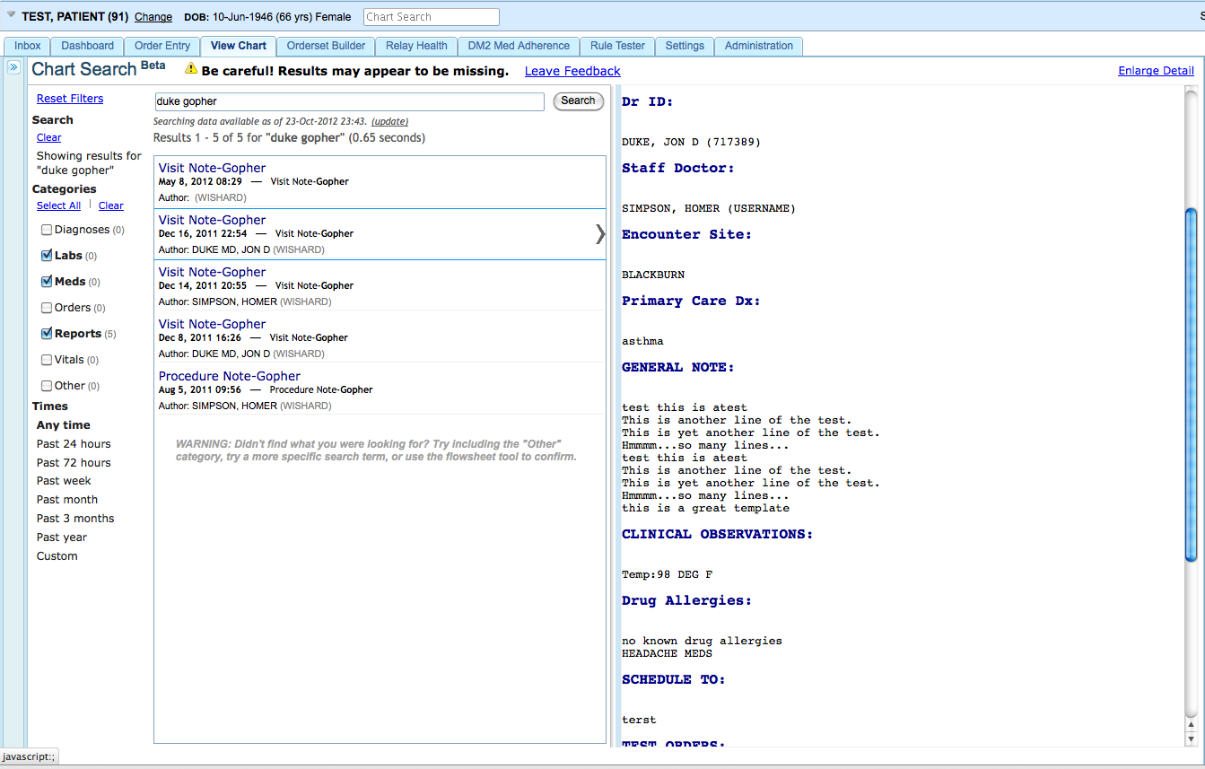

Slide 45
Advancement #4: InfoPanel
The InfoPanel houses a ‘stream’ of information from different sources
Non-interruptive alerts
Clinical calculators
Study reminders
Situational awareness of chart access
Instant messaging

Slide 46
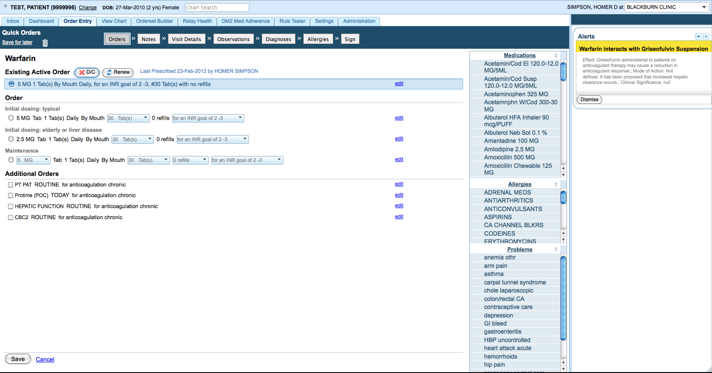
Non-interruptive Alerts
Adherence study
ADEWS study

Slide 47
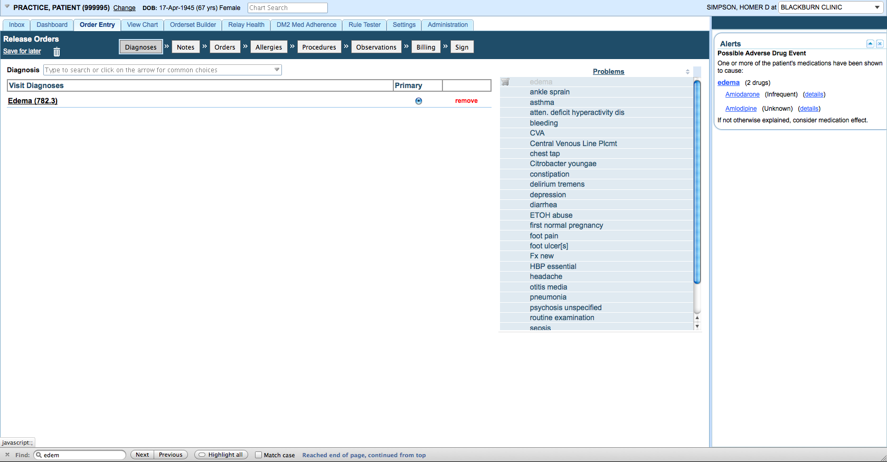
Adverse Drug Event Early Warning System
Adherence study
ADEWS study

Slide 48
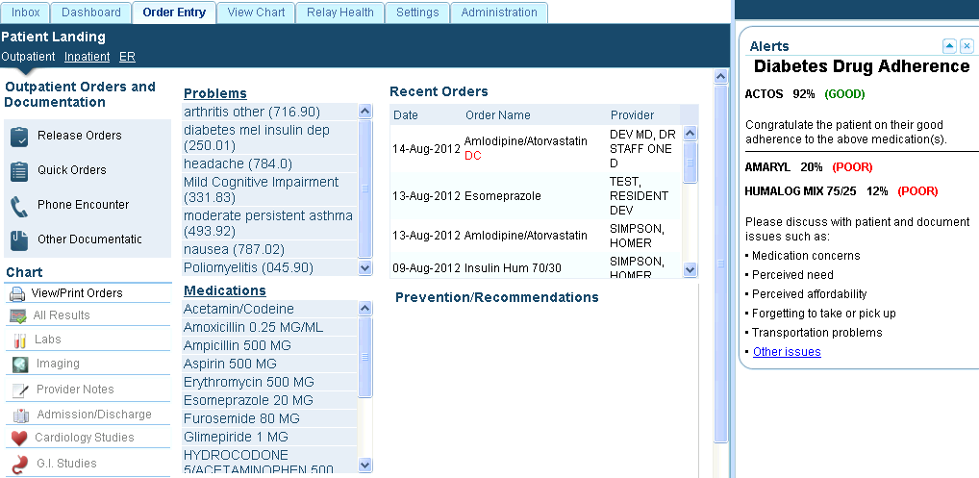
Adherence Information

Slide 49
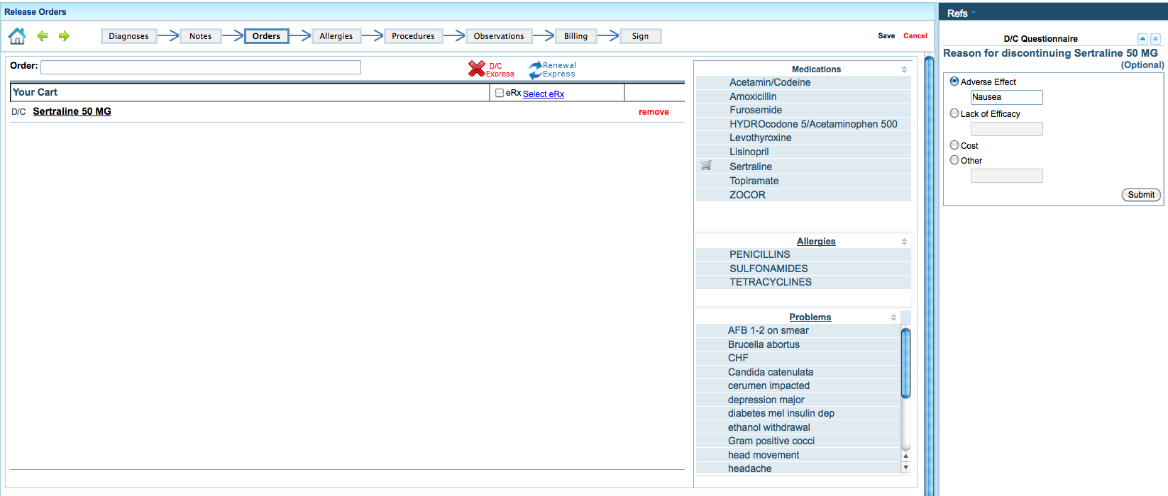
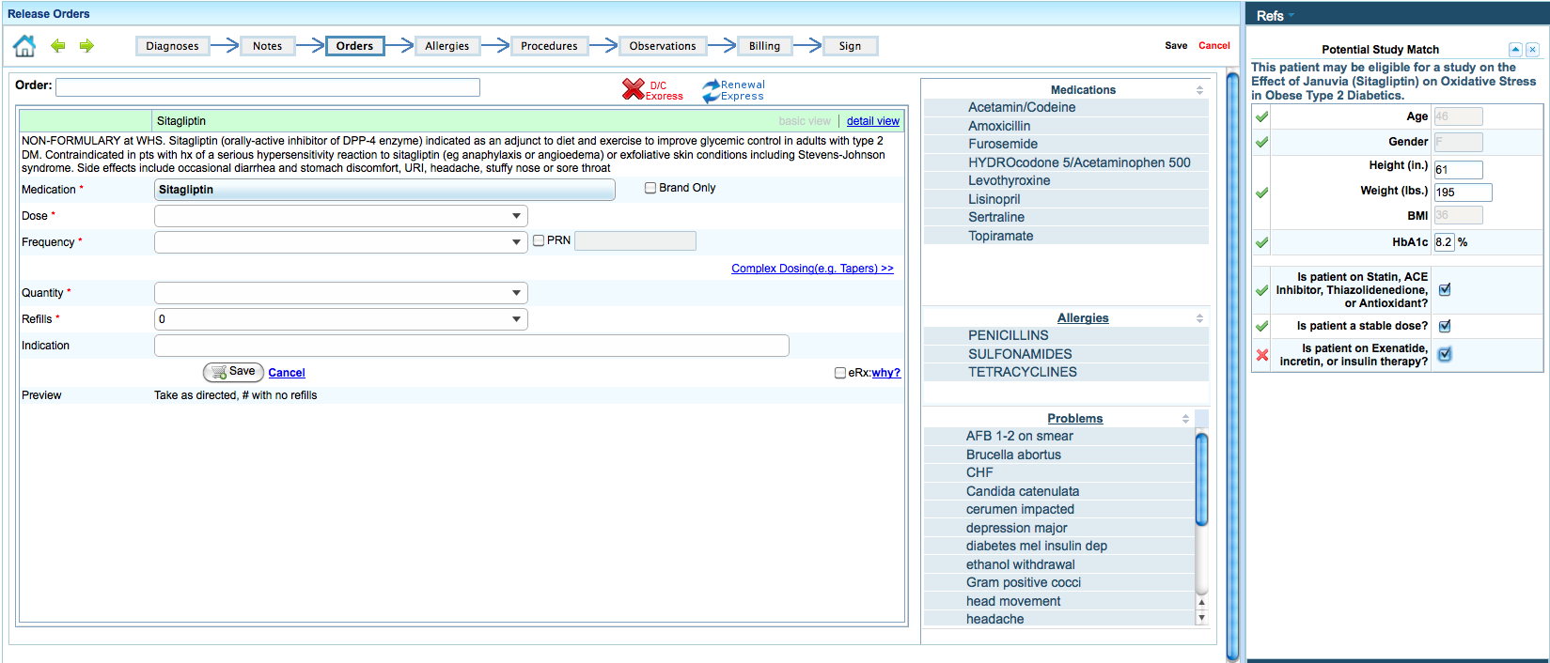
Research Study Eligibility

Slide 50
Situational Awareness of Chart Access
Locking of chart by original Gopher system was not popular with users
Must balance multi-user access with need to ensure awareness of current activity on patient

Slide 51
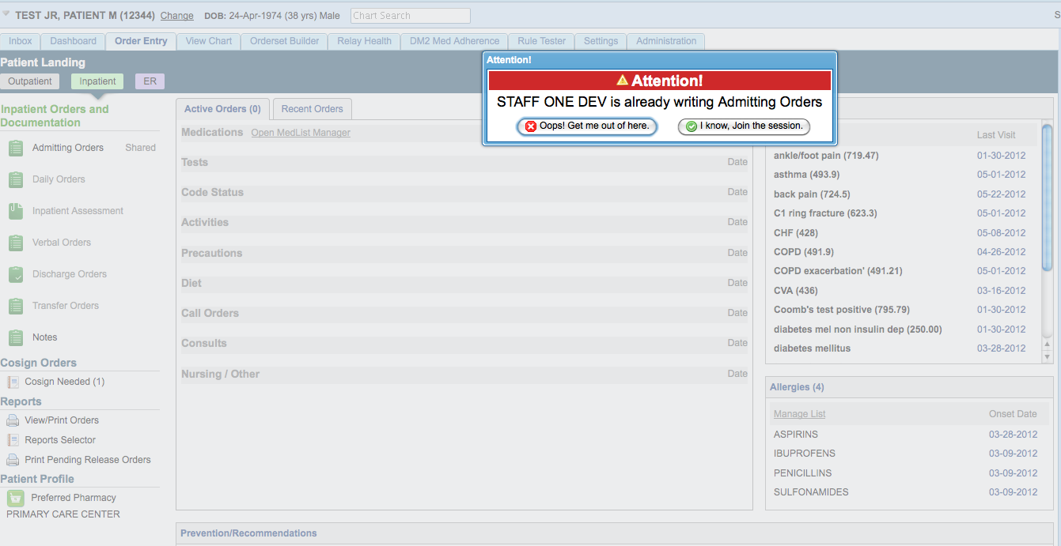
Situational Awareness of Chart Access
Notes:
? Leave this out?

Slide 52
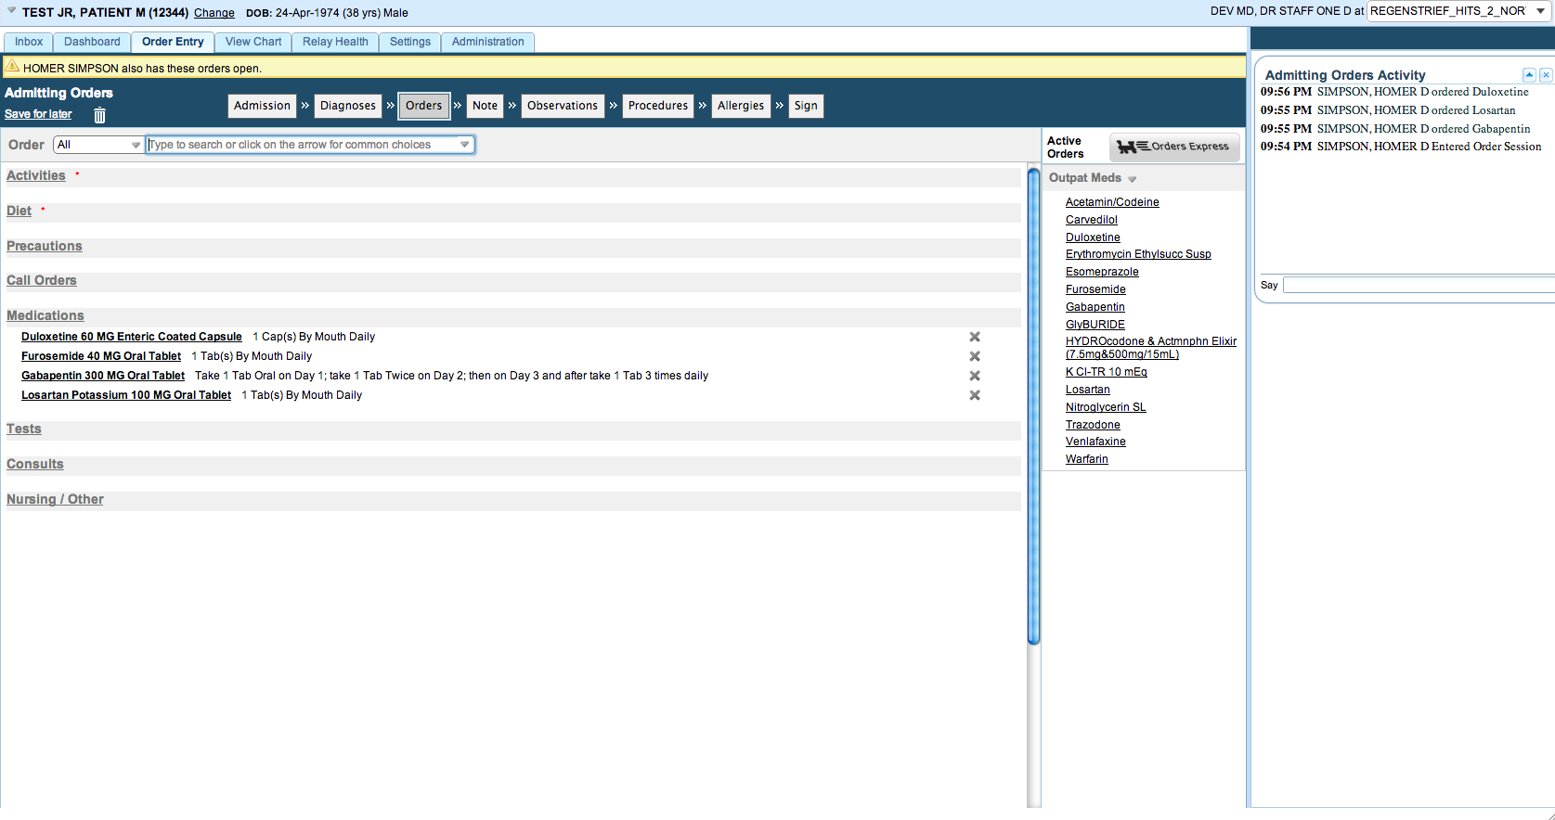
Situational Awareness of Chart Access
Notes:
? Leave this out?

Slide 53
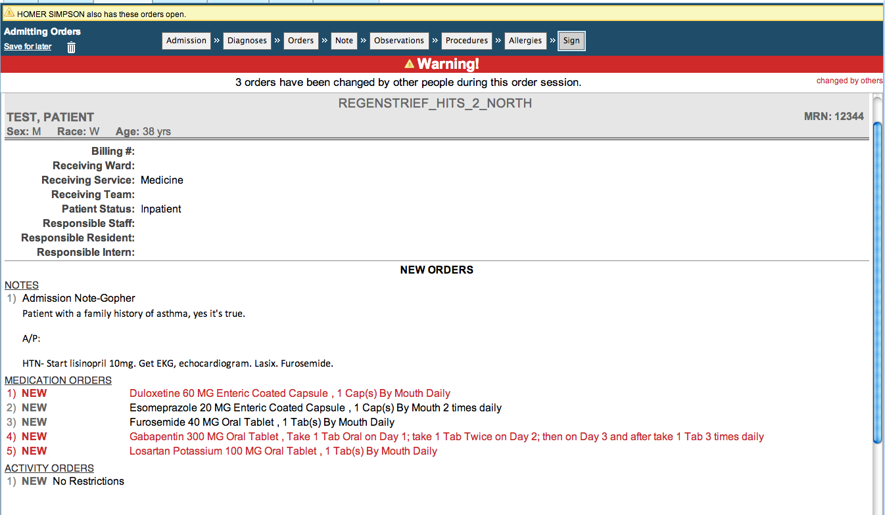
Situational Awareness of Chart Access
Notes:
? Leave this out?

Slide 54
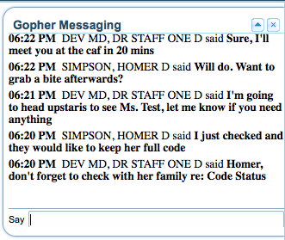
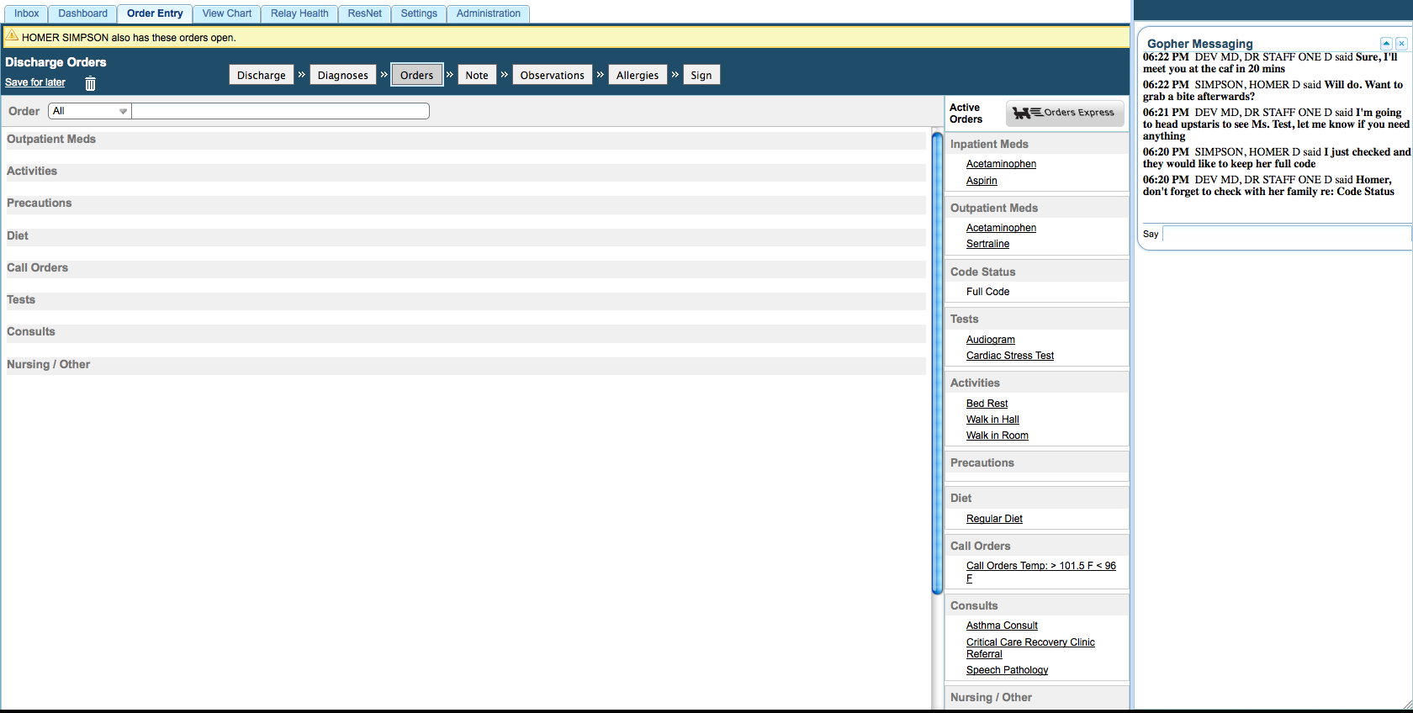
Instant Messaging

Slide 55
Advancement #5: Recipe Authoring
Rule authoring
Creating rules to drive decision support logic
Necessary for knowing what alerts should be shown when

Slide 56
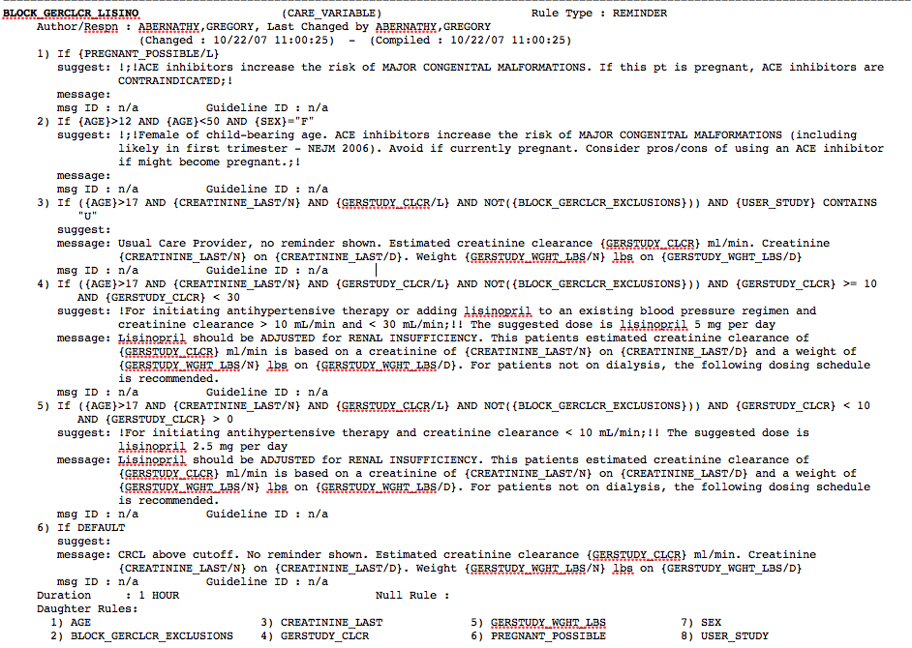

Slide 57
Advancement #5: Recipe Authoring
In G3, we are broadening the concept of rule authoring
Introducing the notion of Recipe Authoring

Slide 58
Good artists copy.
Great artists steal.
- Pablo Picasso

Slide 59
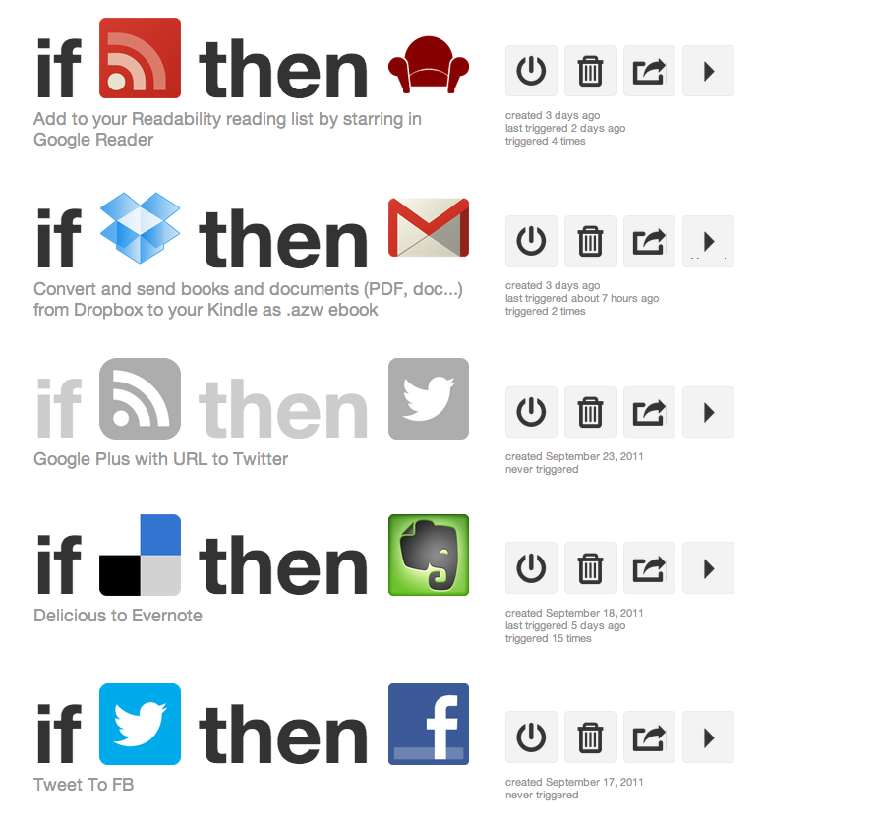
Great Artists Steal

Slide 60
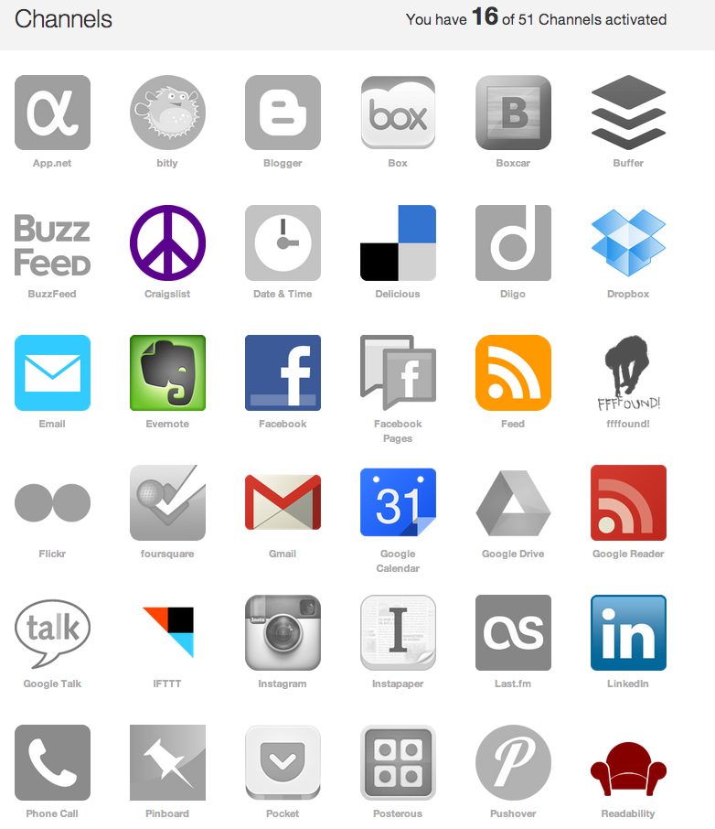

Slide 61
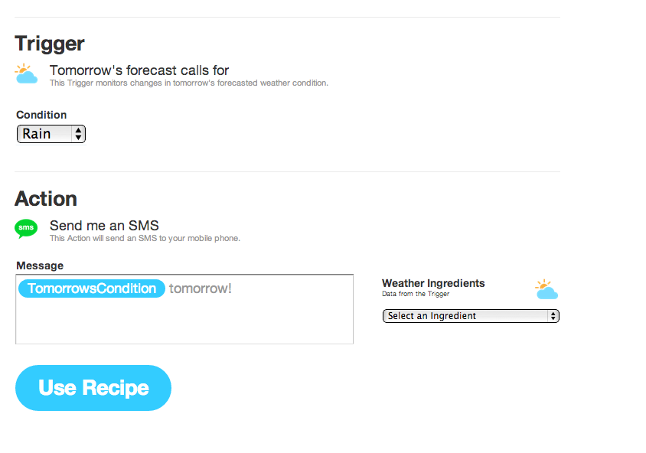

Slide 62
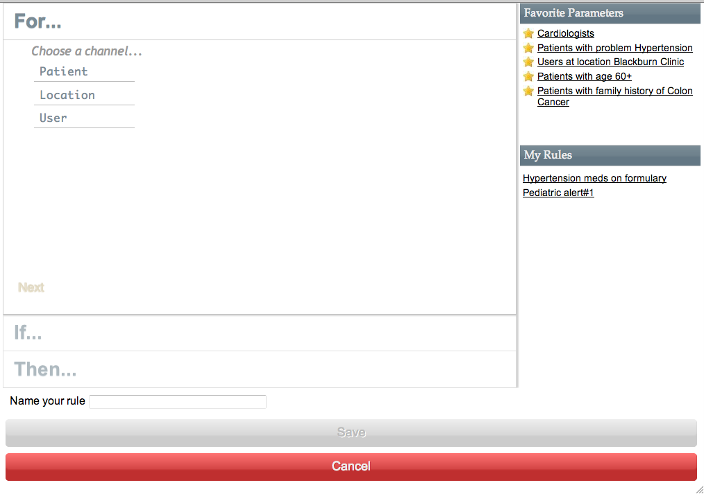

Slide 63
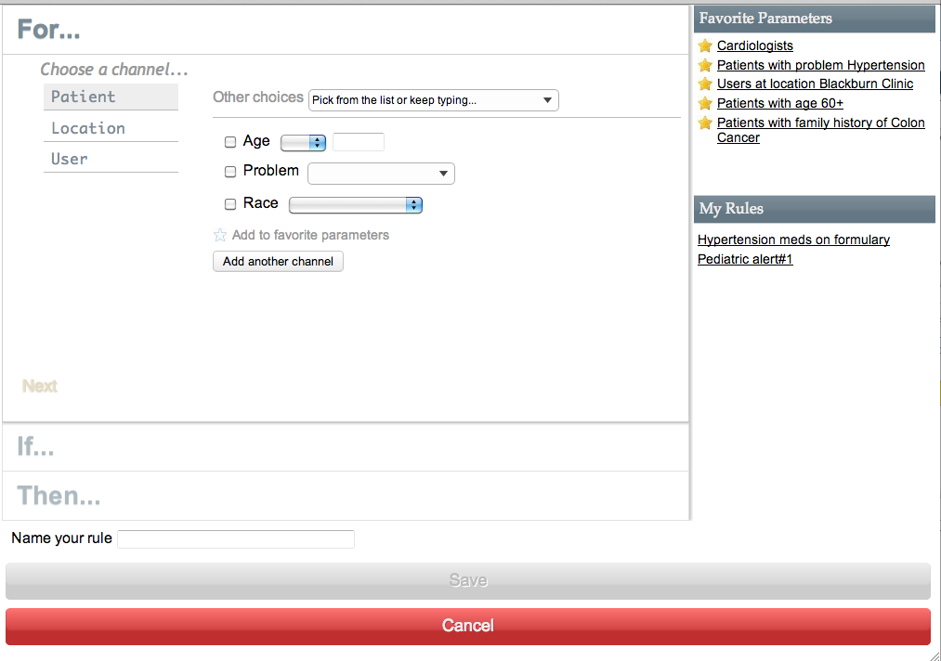

Slide 64
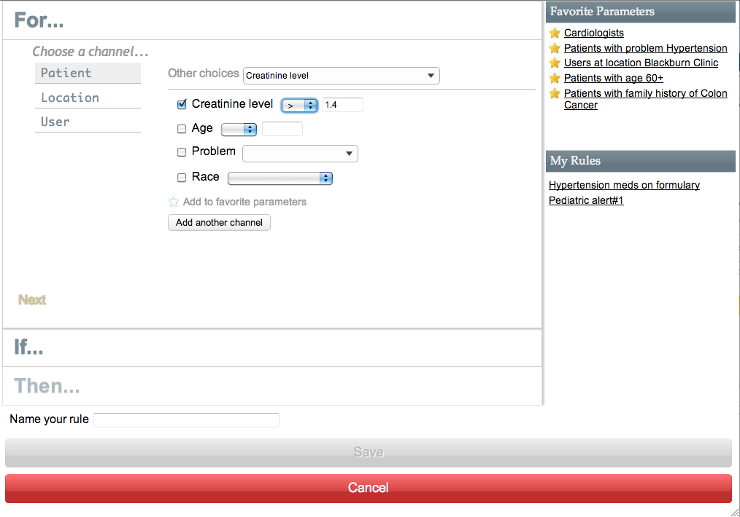

Slide 65


Slide 66
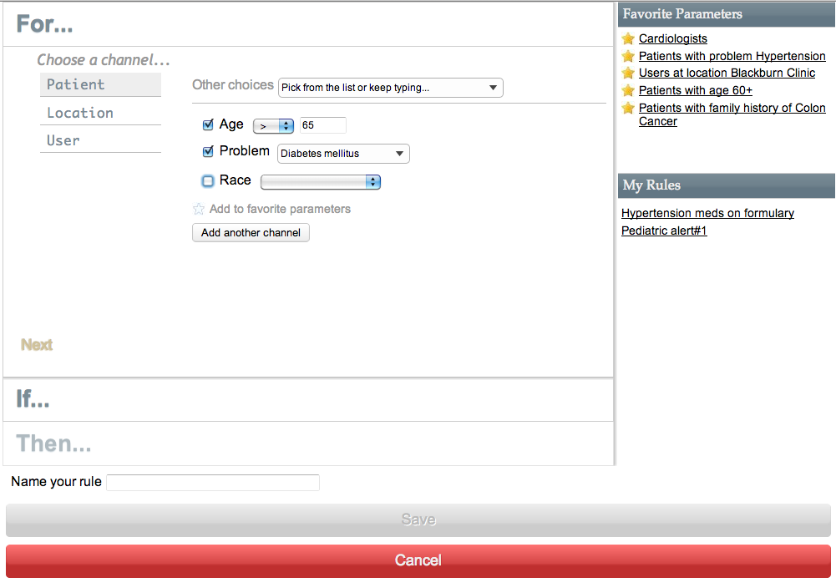

Slide 67
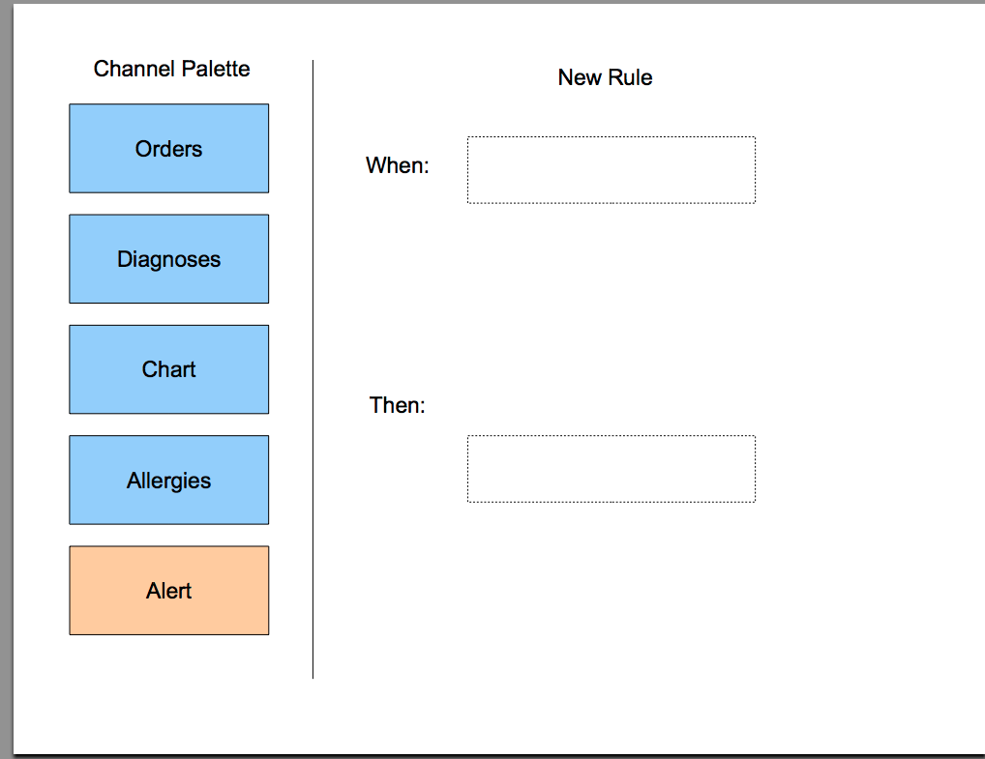
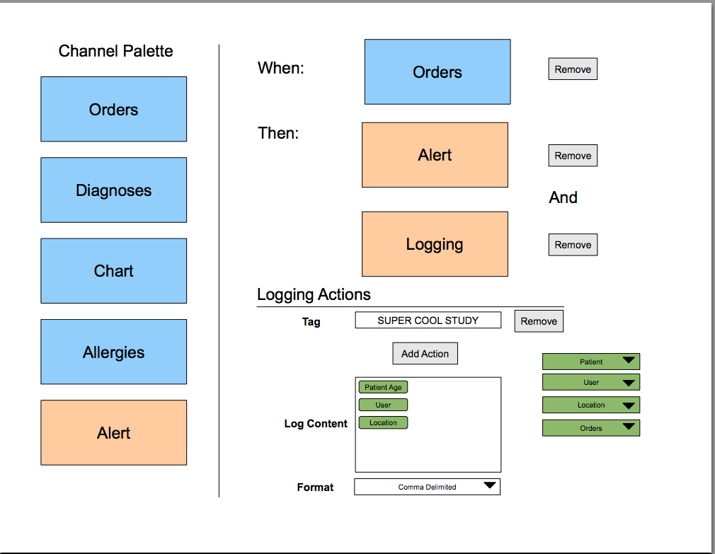

Slide 68
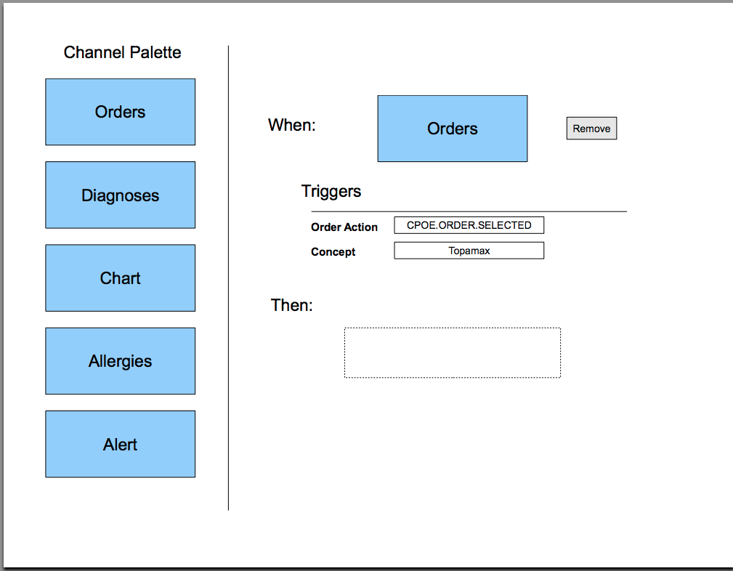

Slide 69
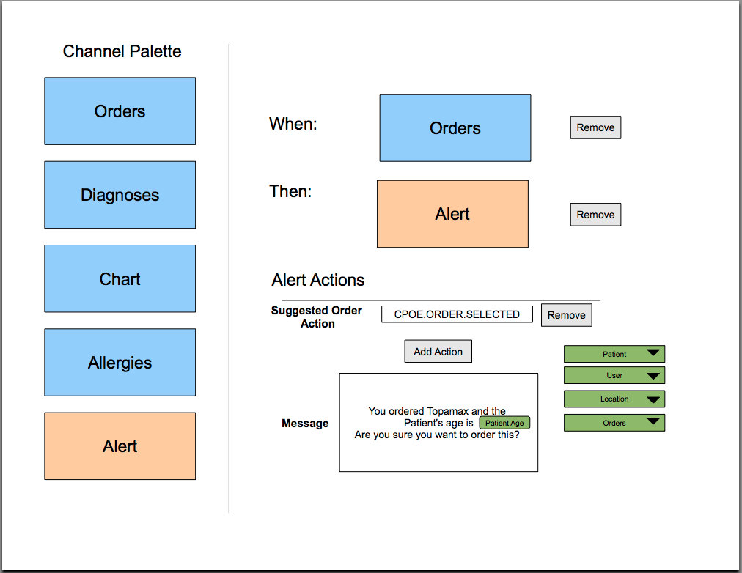

Slide 71
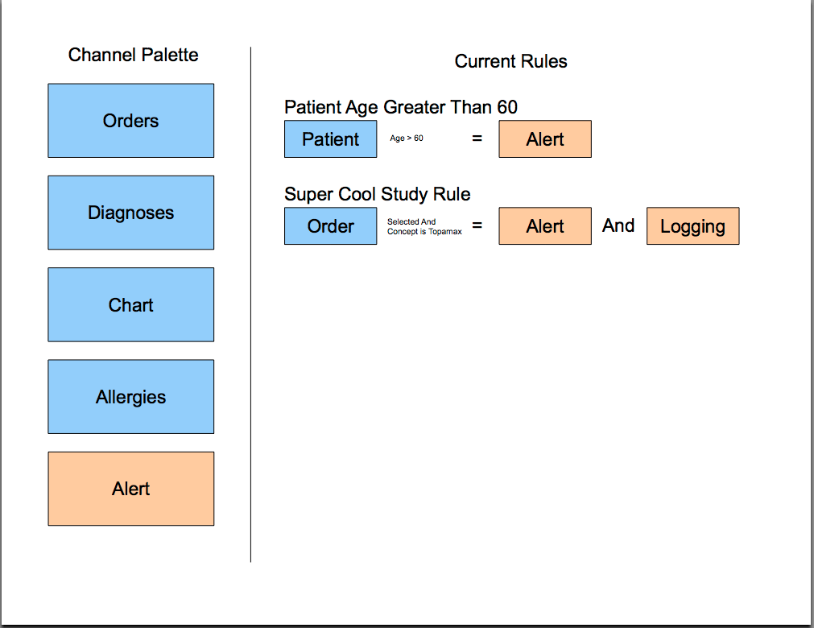

Slide 72
Recipe Authoring = Customization
Design your own alerts
Design your own NLP triggers
Design your own studies

Slide 73
Gopher Demo
Notes:
Demo Server: https://172.30.204.24/CareWebDemo/careWeb.zul
App Dev: https://app-devel.regenstrief.org/CareWebWishard/zkau/web/org/regenstrief/framework/ui/security/impl/loginWindow.zul

Slide 74
5 Advancements in CDS
Dynamic Alerting
Real-Time Natural Language Processing
Chart Search
InfoPanel
Recipe Authoring

Slide 76
Acknowledgements
Chris Beesley
Chris Bonham
Mike Brehm
Jason Cadwallader
Joshua Castagno
Vidhya Chari
Parishkar Chauhan
Ling Cheng
Sireesha Chilukuri
Cyril Colvard
Jonathan Cummins
Alex Franken
Cindi Hart
Charity Hilton
Joshua Jones
Warren Killian
Jeremy Leventhal
Allen Logan
Ernesto Maldonado
Burke Mamlin
Andrew Martin
Doug Martin
Jim Meeks-Johnson
Pat Milligan
Justin Morea
Chris Power
Linas Simonaitis
Kenneth Spry
Jeff Stroup
Blaine Takesue
David Taylor
Jeff Warvel
Jennifer Weatherspoon
Chen Wen

Slide 77

Questions?
jduke@regenstrief.org

